Slide 1
Custom Models Vs. Foundation Models (ChatGPT - 4o): Do We Really Need Task-Specific Models for CDT Scoring?
A Zero-Shot Learning Approach for Cognitive Assessment

Slide 2
Objective: Assess the feasibility of using ChatGPT- 4o as a neuropsychology expert for Clock Drawing Test(CDT) scoring
Dataset: NHATS (National Health and Aging Trends Study)
Steps Taken:
Converted SAS data to XLSX for easier handling
Filtered records to include only those with CDT scores
Selected Demographic Features:
Age perception (R13 WB3 AGE YOU FEEL MOST OF TIME)
Race & ethnicity (R13 D RACE AND HISPANIC ETHNICITY WHEN ADDED)
Longest occupation category (R13 D LONGEST OCCUPATION CATEGORY)
Clock drawing images included as primary input

Slide 3
The CDT score ranges from 0 to 5, indicating cognitive ability:
Score | Meaning
0 | No clock drawn
1 | Severely impaired clock, unrecognizable
2 | Moderate impairment, missing key elements
3 | Mild impairment, incorrect time or misplaced numbers
4 | Minor errors, mostly correct
5 | Perfect clock with all elements accurate

Slide 4
Why ChatGPT-4o?
Advanced multi-modal capabilities
Can process both text and images
Potential for automated cognitive assessment
Prompt Used:
"You are a neuropsychology expert analysing digital clock drawings. Evaluate the provided clock drawing test and assign a score from 0 to 5. The score reflects cognitive performance, considering standard neuropsychology criteria."

Slide 5
Experiment Setup
Input Data:
60 Samples Total (10 from each CDT category)
Used Zero-Shot Learning → No prior CDT-specific training
Tested in two modes:
With Patient Info (Age, Race, Education)
Without Patient Info (Only Image Input)

Slide 6
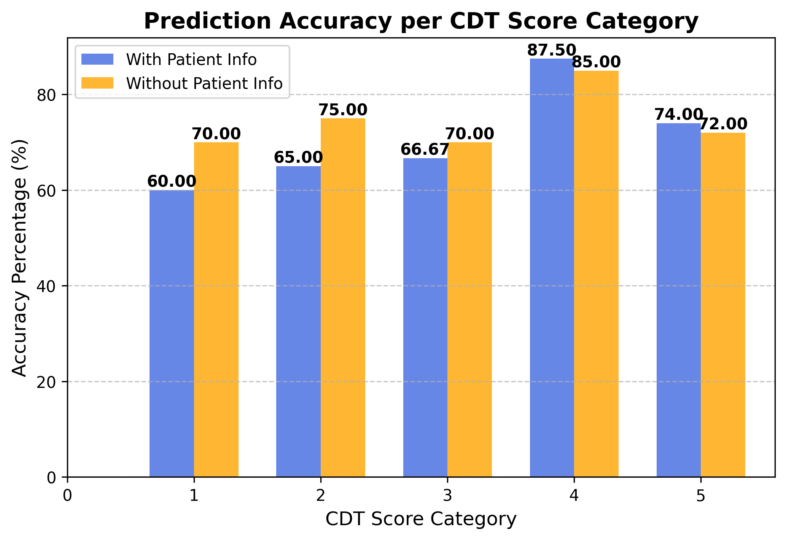

Slide 7
Overall Accuracy
60 samples with 10 samples from each of 0 - 5
Version | RMSE | Regression Accuracy
With Patient Info | 0.9661 | 0.6933
No Patient Info | 1.0165 | 0.7067

Slide 8
Next Steps:
Experiment with larger sample size.
Use few-shot learning by providing examples in the context.
Adjust Prompt to see if it improves results.
Train a custom model using the NHATS dataset and compare its performance with ChatGPT- 4o.
Benchmark against State-of-the-Art Foundation Models like Gemini 2 Flash, Anthropic Claude 3.5 Sonnet, Grok 3, VideoLLaMa 3, Llama 3.2, Pixtral 12B

